Slide 1

G2M Case Study
Exploratory Data Analysis
20 - Jan - 2022

Slide 2
Background
What is the business problem?
XYZ is an investment firm in the U.S.. The firm is trying to investigate the Cab industry and target a firm as its next investment.
Objective: Make investment recommendations via exploratory data analysis

Slide 3
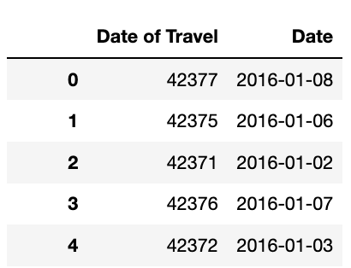
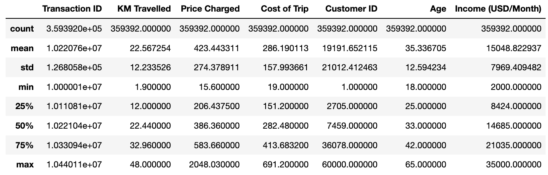
Data Preprocessing & Summary
4 data files: Cab_Data.csv, City.csv, Customer_ID.csv, Transaction_ID.csv
Step 1: Merge Data
Step 2: Column Transformation
Column “Date of Travel” is serial number -> transform to a readable format
Step 3: Check Null Values
No presence of null values
Step 4: Duplicated Values
No presence of duplicated values
Step 5: Summary Statistics
One extreme value in “Price Charged”
column. Will assume no additional
information is available for validation
Step 6: Construct New Columns
”Profit” = “Price Charged” – “Cost of Trip”

Slide 4
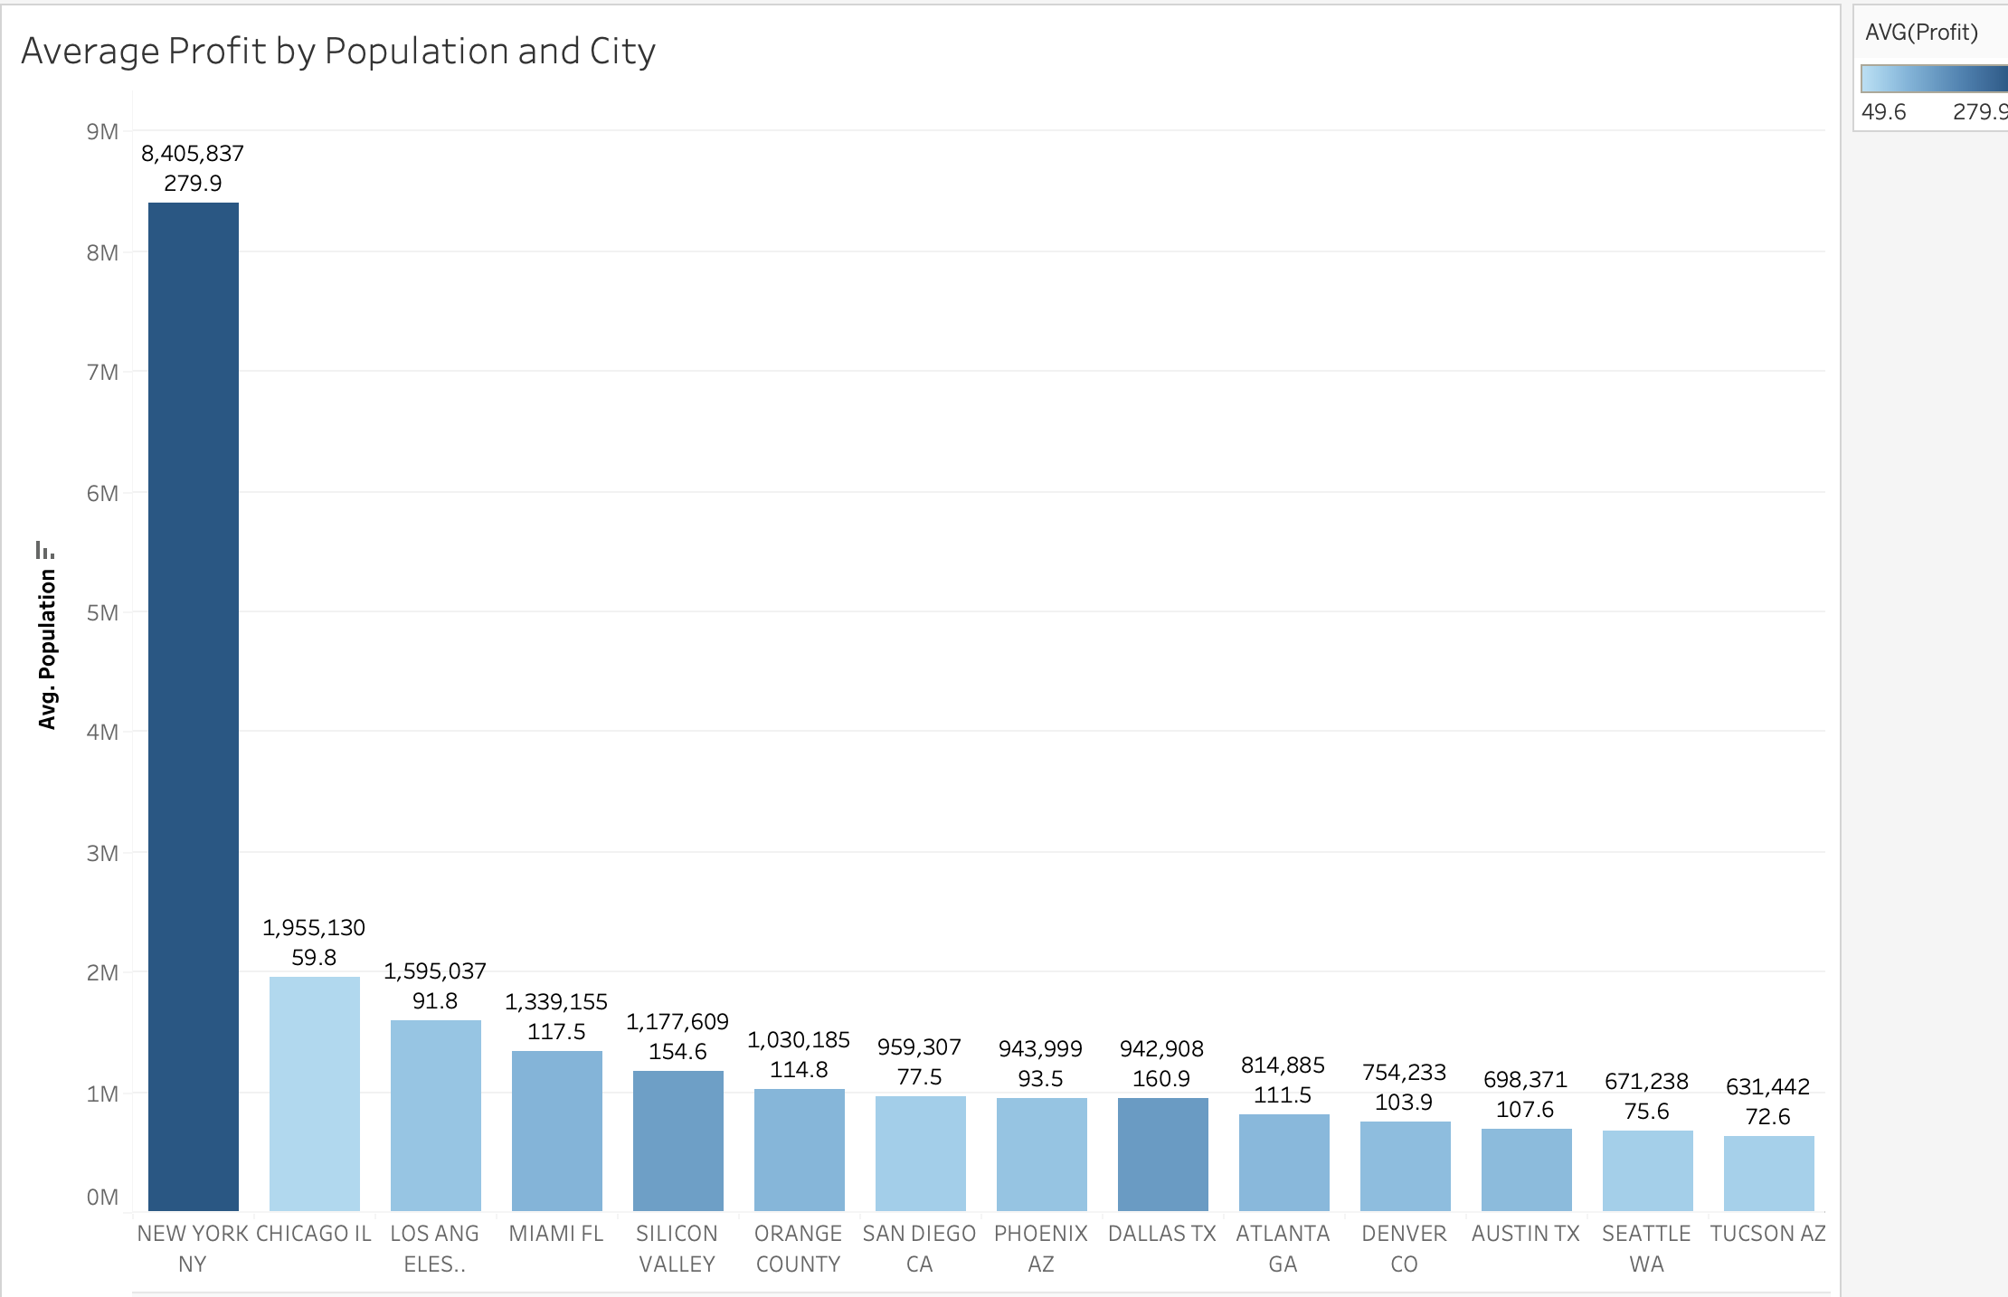
Assumption 1:
Do metropolitans with large population have higher average profit than other areas?
Insights:
1. Except Chicago, cities with relatively larger population tend to generate more profits
2. New York is the city where has the highest average cab profits

Slide 5
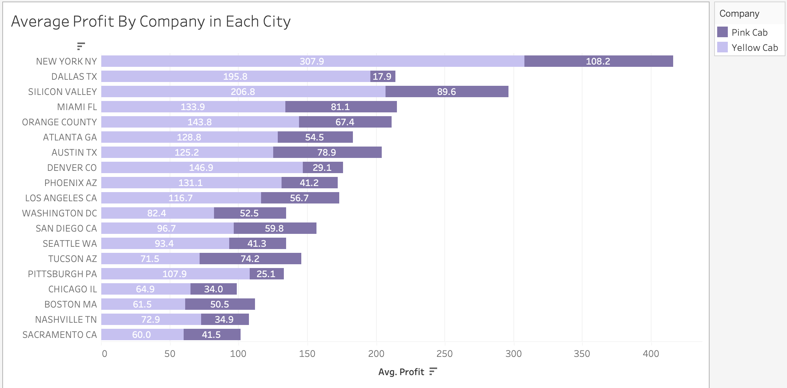
Assumption 1 (Continued):
Do metropolitans with large population have higher average profit than other areas?
Except Tucson AZ, all other cities have more profits from Yellow Cab than from Pink Cab

Slide 6
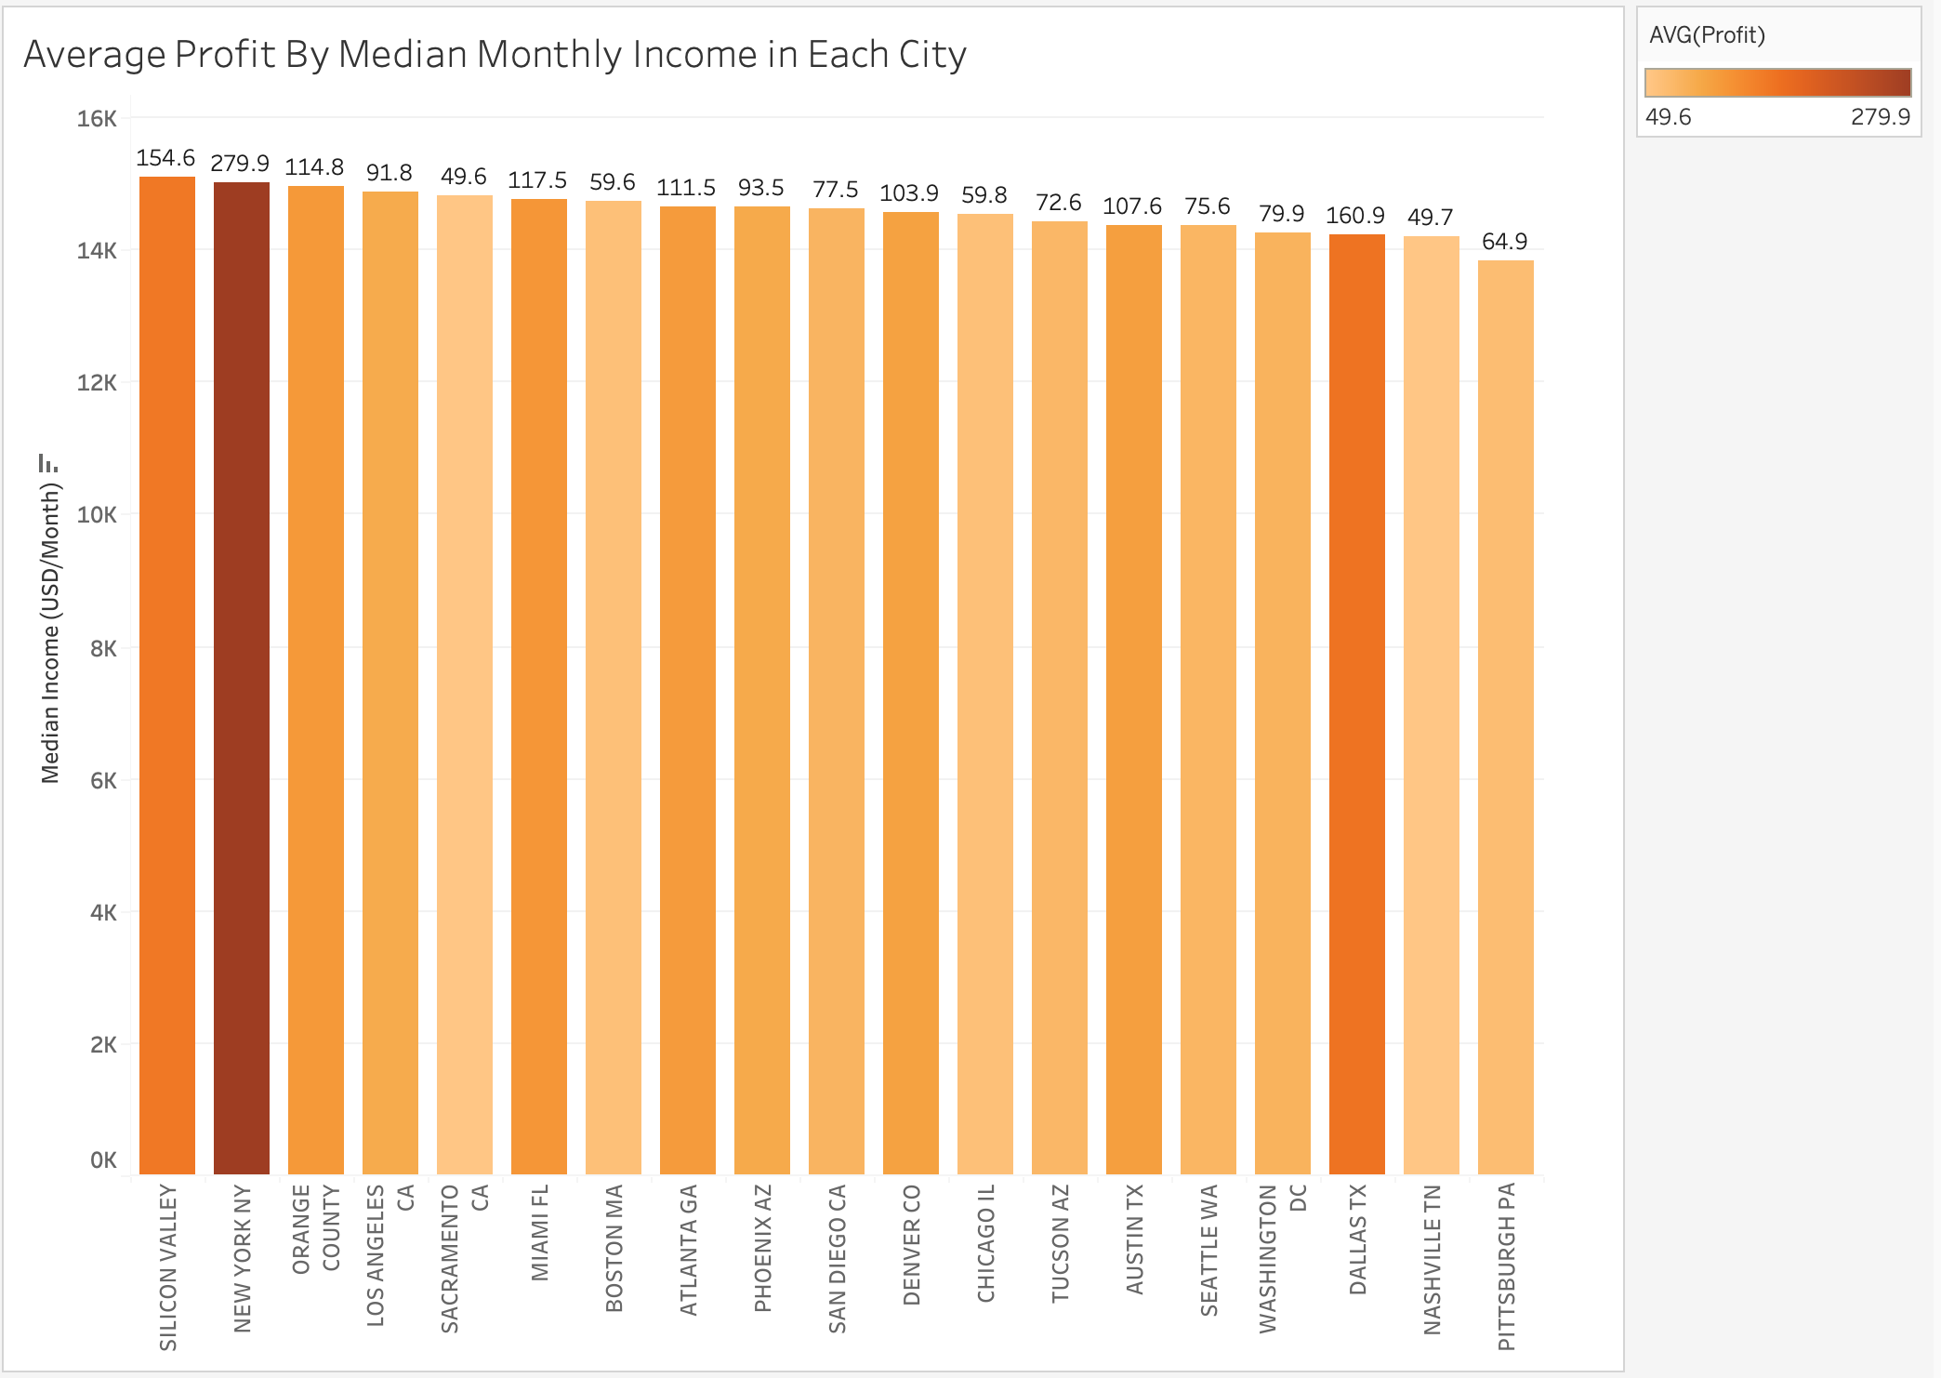
Assumption 2:
Do cities where people have high income level tend to generate higher profits?
Cities where have relatively higher median monthly income do not indicate higher cab profits, such as Sacramento CA which has the lowest average cab profits but has the fifth highest median income level

Slide 7
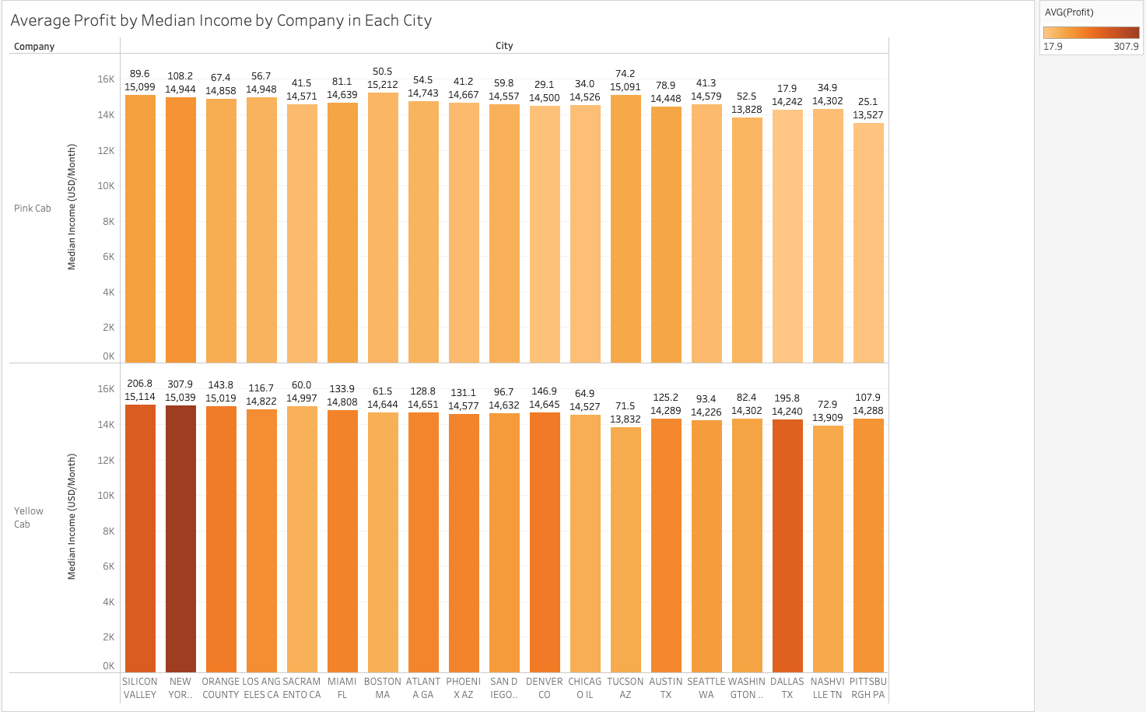
Assumption 2 (Continued):
Do cities where people have high income level tend to generate higher profits?
Yellow Cab performs better regardless of the income level

Slide 8
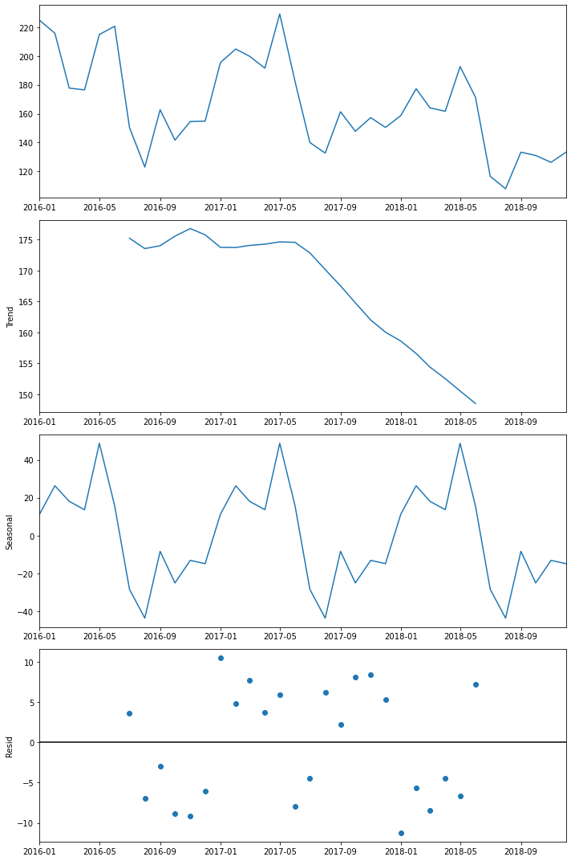
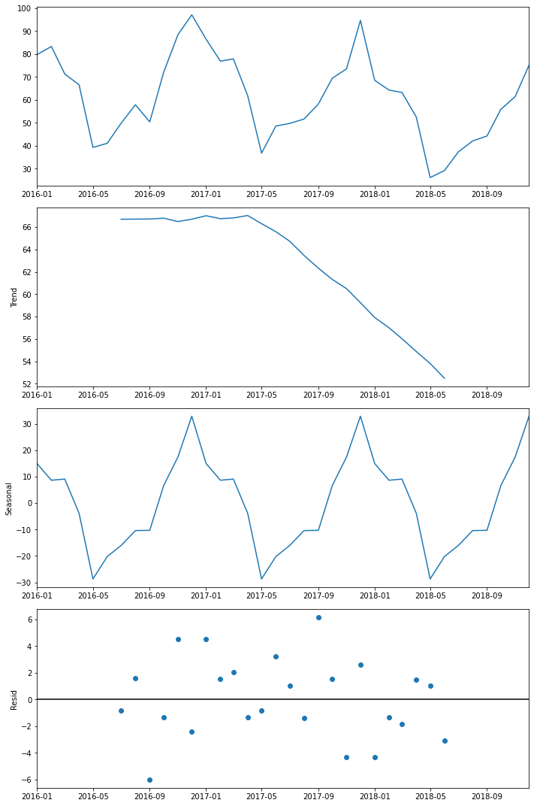
Assumption 3:
Does profits have seasonality?
Yellow Cab
Pink Cab
Yellow Cab has seasonality in the middle of a year
Pink Cab has seasonality around the end of a year
The average profits for both companies trend downward

Slide 9
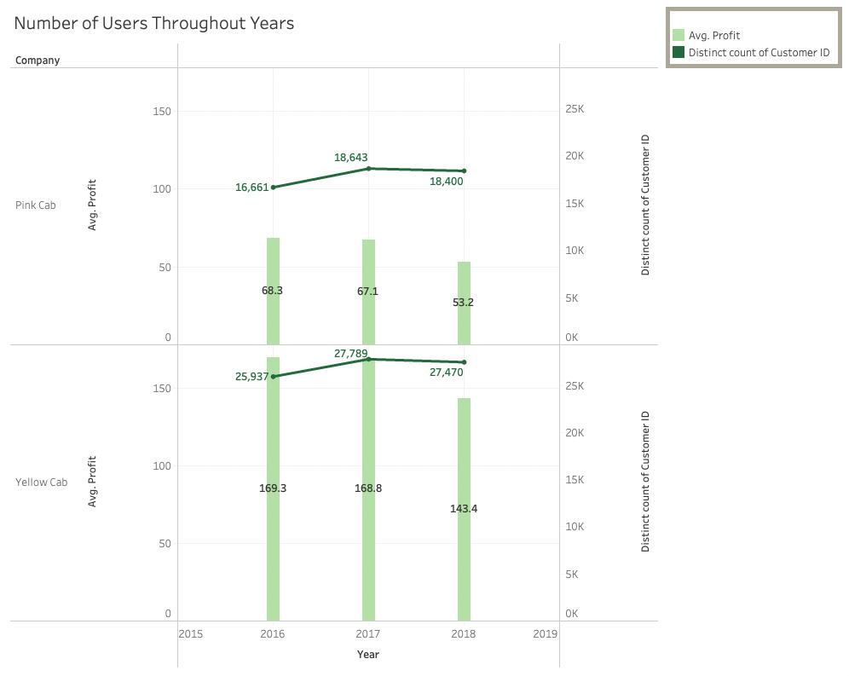
Assumption 4:
Is the number of customers positively related to the profits?
By looking the average profits throughout three years, both companies perform worse in 2018
The number of customers goes up in 2017 but with less profit, which indicates the profit does not have a high quality
Yellow Cab still, however, outperforms Pink Cab

Slide 10
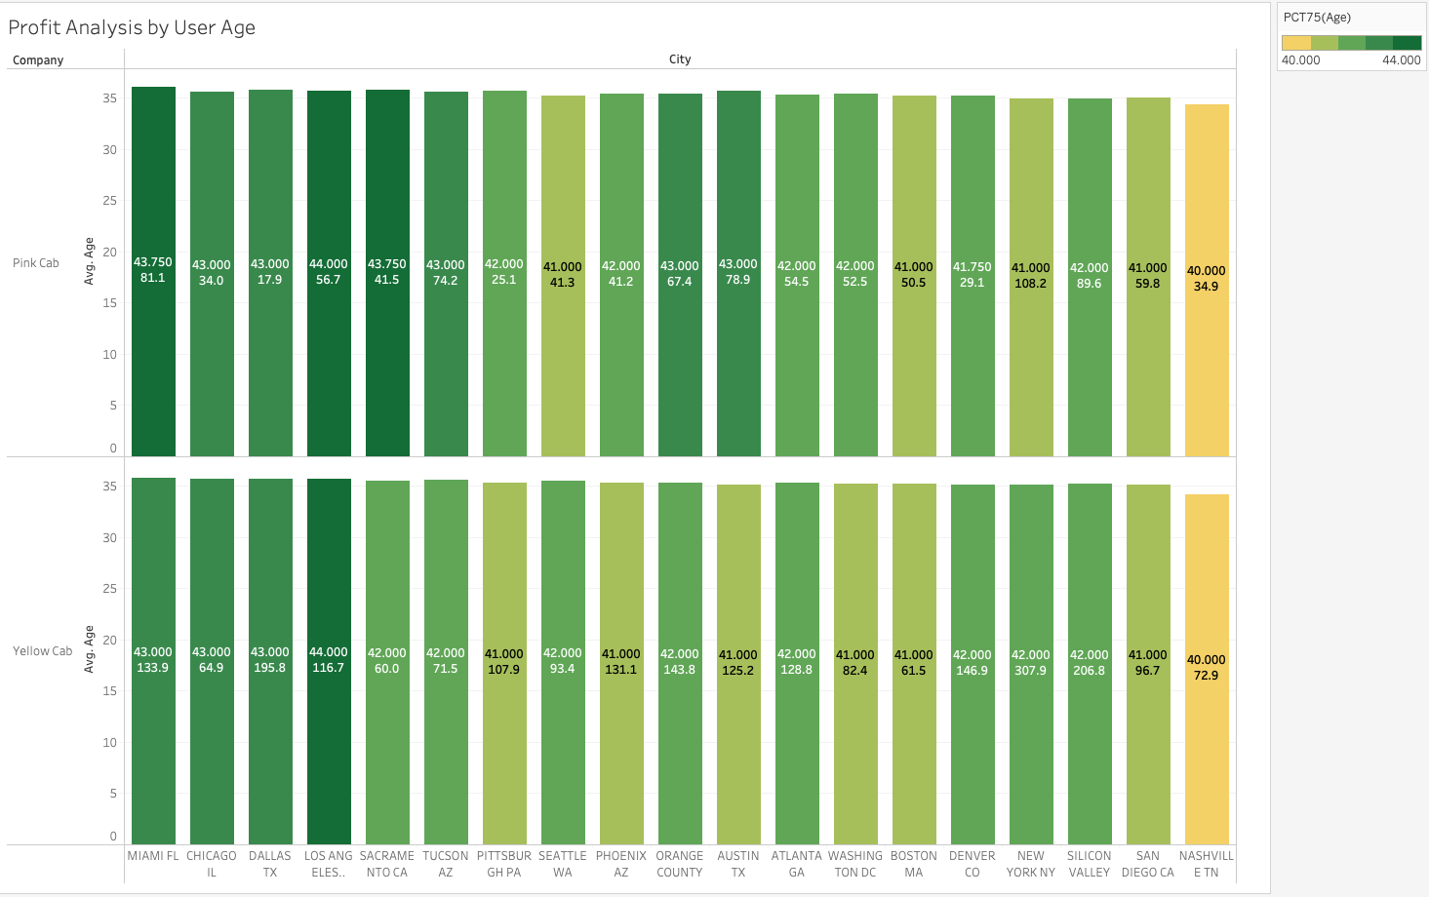
Assumption 4 (Continued):
Is the number of customers positively related to the profits? What about age?
Overall speaking, Yellow Cab has younger population of customers, which is potentially the engine for profit-generating.

Slide 11
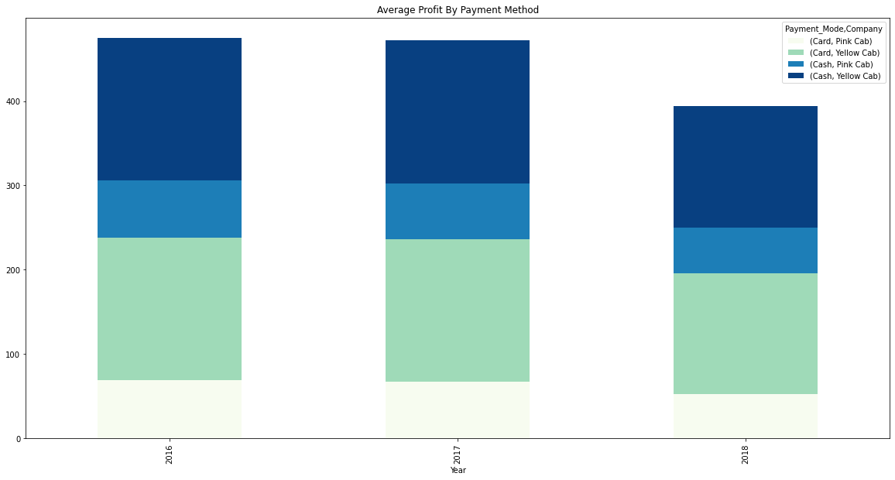
Assumption 5:
Which payment method people are more likely to use?

Slide 12
Recommendations
Population dimension: Yellow Cab performs better in most of the cities and outperforms way better in metropolitans with large population
Income dimension: Yellow Cab performs great in cities with high median income level. It even outperforms Pink Cab in cities with a relatively low median income level
Seasonality: Yellow Cab have two profit peaks throughout a year, which is around the beginning of a year and the mid of a year. More profits are captured.
Customers dimension: Both companies have a downward sloping average profit trend. The emerging shared rides market may be one of the reasons. Yellow Cab, under such circumstance, still outperforms Pink Cab.
Payment method: The difference of profits generated by different payment modes is neglectable for both companies.
Conclusion: Yellow Cab is a good fit for XYZ’s investment though profits in the Cab industry seems degraded in the recent years.
Data Intake Report: https://drive.google.com/file/d/1iiCCPI7_xgLDwOKtZKnMflLc9iWOhHOj/view?usp=share_link

Slide 13
Thank You

